Slide 1
24F Data Manipulation Techniques - 06
COVID vs
Canadian Stock Market
Puja Shrestha
Kelvin Krisna de Rodrigues Silva
Karan Maheshbhai Mistry

Slide 2
Introduction
This study explains the impact of Covid-19 on the Canadian Stock Market.
By analyzing Covid-19 dataset statistics across Canadian Province and Territories alongside stock performance data, we aim to uncover trends, correlation and pandemic’s impact on market’s activity and recovery.
This project focuses on how health crisis influence on economics dynamics
Notes:
Person 1

Slide 3
Dataset description
Canada COVID-19 Data:
This dataset provides daily COVID-19 statistics across Canadian provinces and territories.
Data Source: Covid19 Data Worldwide
Data Size: 8,752 rows and 8 columns.
Use Cases: COVID-19 trends, impacts, and tracking pandemic progress over time.
Canada Stock data:
This dataset includes stock performance data for companies in Canada.
Data source: Yfinance Library [^GSPTSE, BNS.TO, WCP.TO, SES.TO, POW.TO, ENGH.TO, RUS.TO, IAG.TO, FC.TO, CNQ.TO, RY.TO]
Data Size: 18,852 rows and 8 columns.
Use Case: Stock Performance, volume data.

Slide 4
Dataset Cleanup
Extracted covid 19 data for Canada
Extracted the Stock data from Yfinance library.
Include the Asset Name for each stock
Changed the date timestamp to general date format
Removed the unwanted columns: unnamed 0

Slide 5
Questions
Which province has the highest number of cases?
How has the Stock Market been affected by COVID?
How has the volume of transaction been affected by COVID?
How did different stocks recovery during and after COVID?

Slide 6
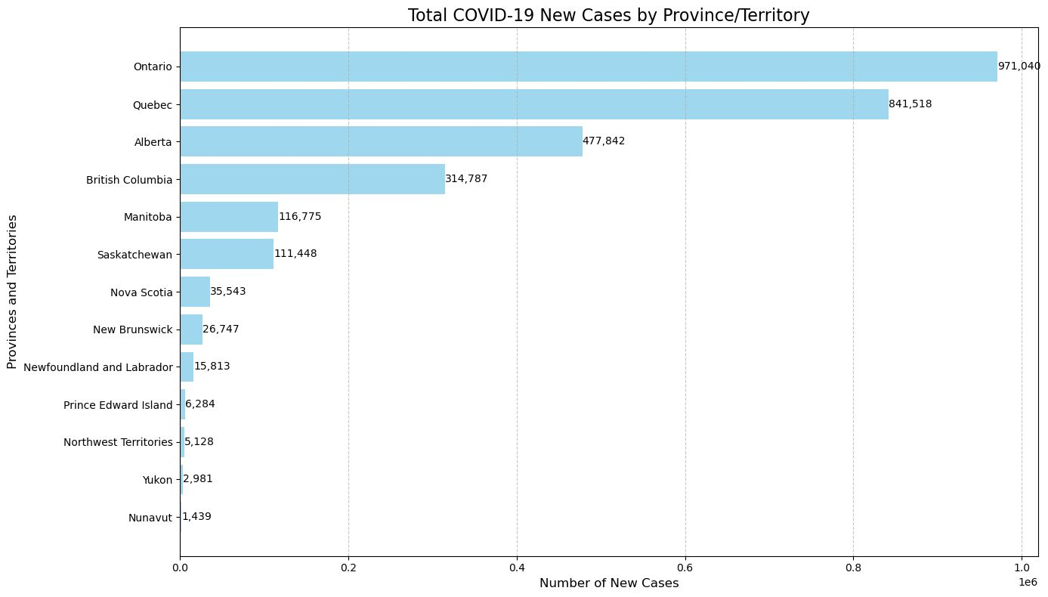
Total of Cases by Province

Slide 7
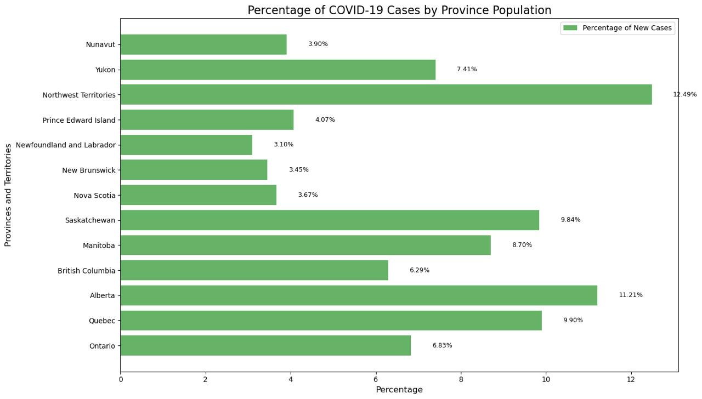
Percentage of Cases by Province Population

Slide 8
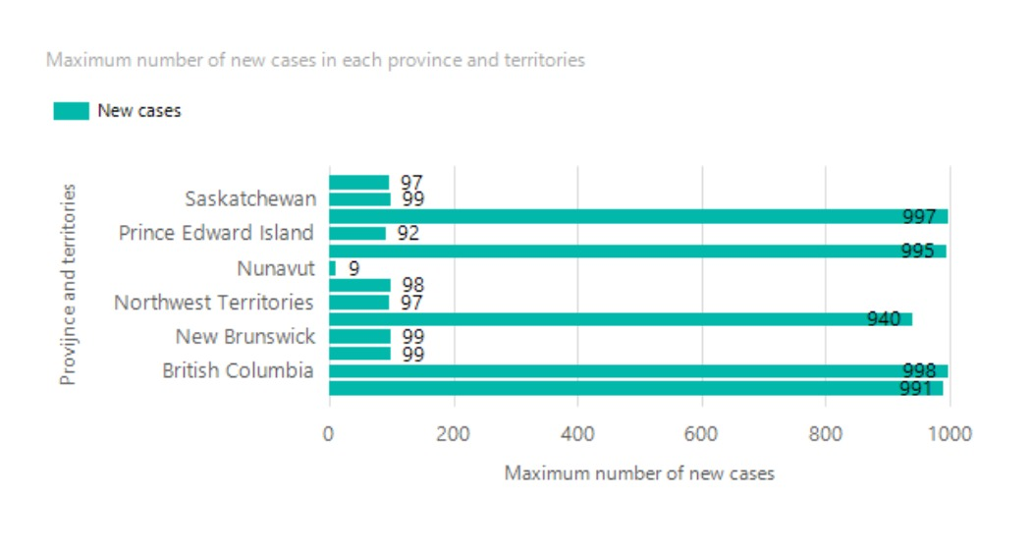
Maximum number of new cases daily by Province

Slide 9
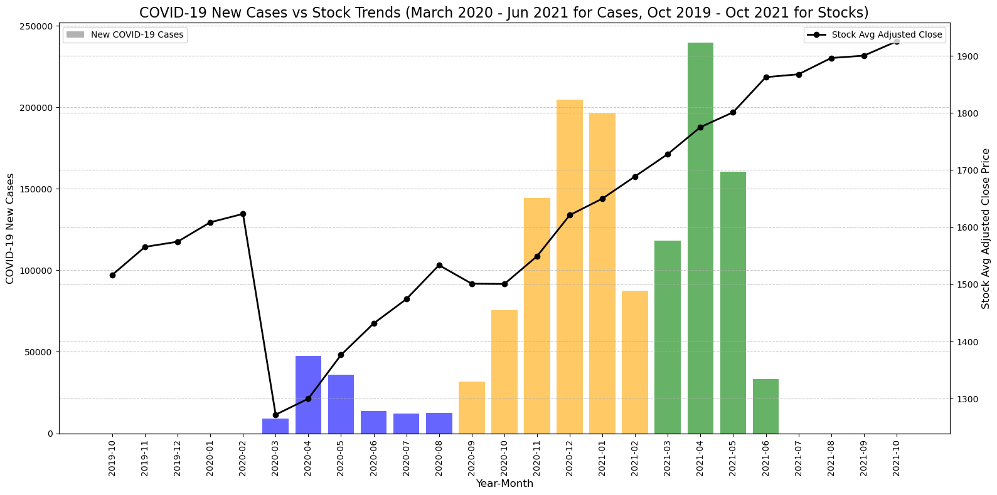
Stocks price variation

Slide 10
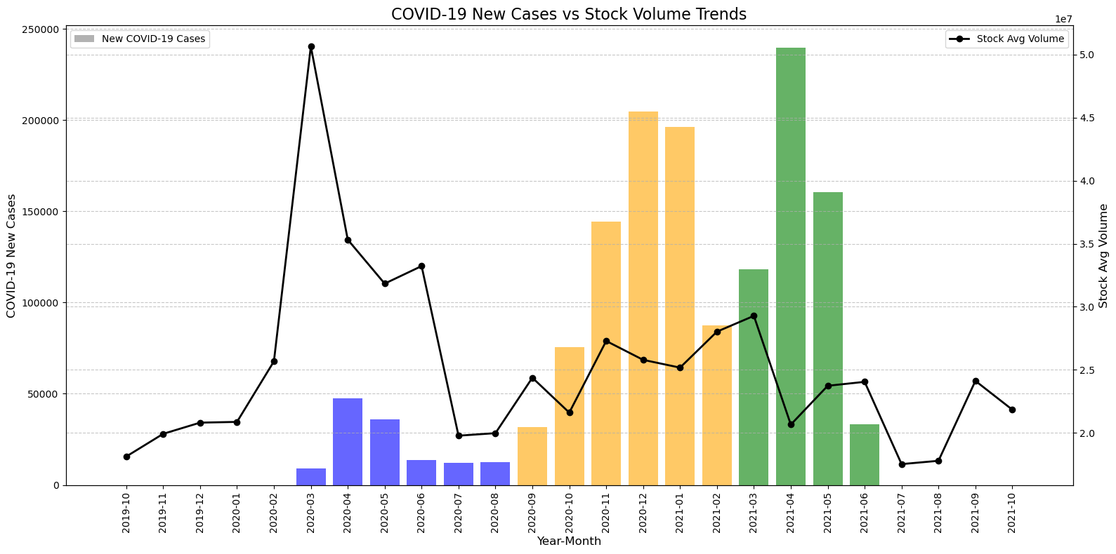
Volume of transactions

Slide 11
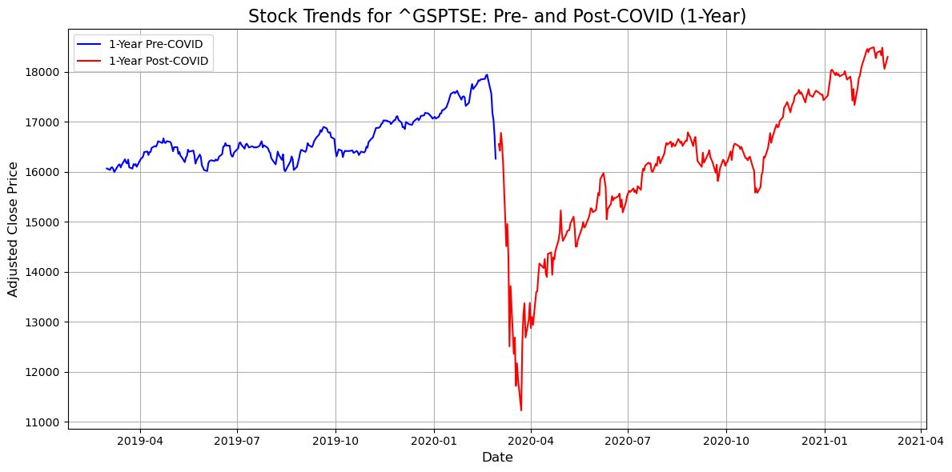
S&P/TSX Composite index
The S&P/TSX Composite Index is a capitalization-weighted equity index that tracks the performance of the largest companies listed on Canada's primary stock exchange, the Toronto Stock Exchange (TSX).

Slide 12
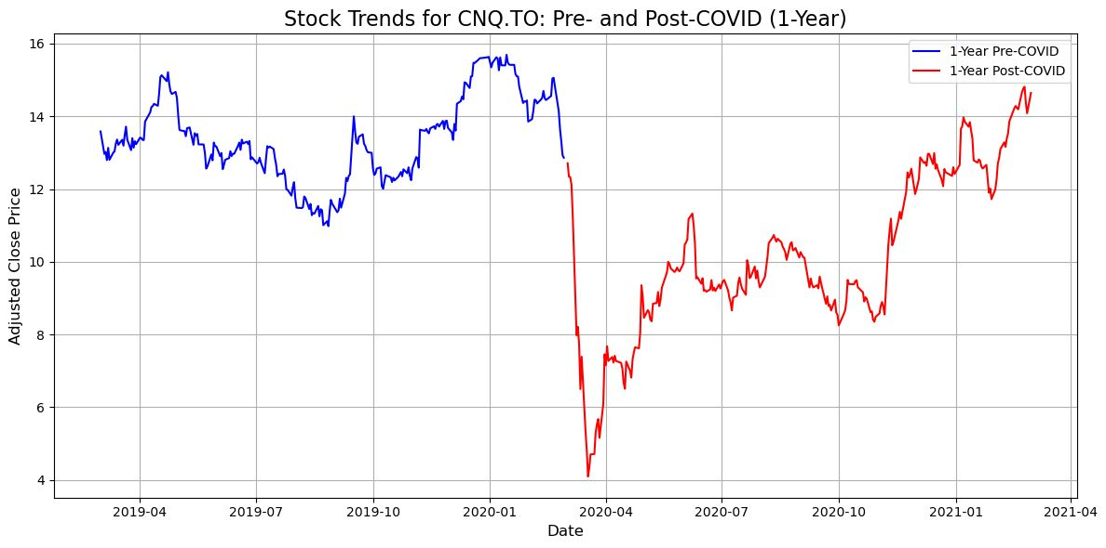
CNQ - Canadian Natural Resources Limited
Sector: Energy
Industry: Oil & Gas E&P
Full Time Employees: 10,272

Slide 13
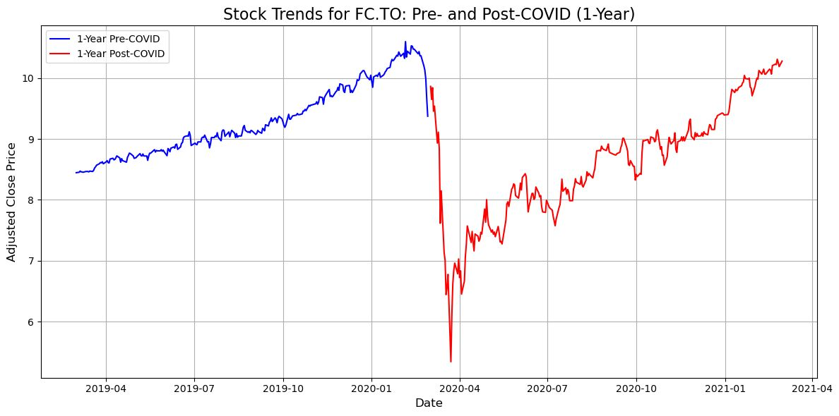
FC - Firm Capital Mortgage Investment Corp
Sector: Financial Services
Industry: Mortgage Finance

Slide 14
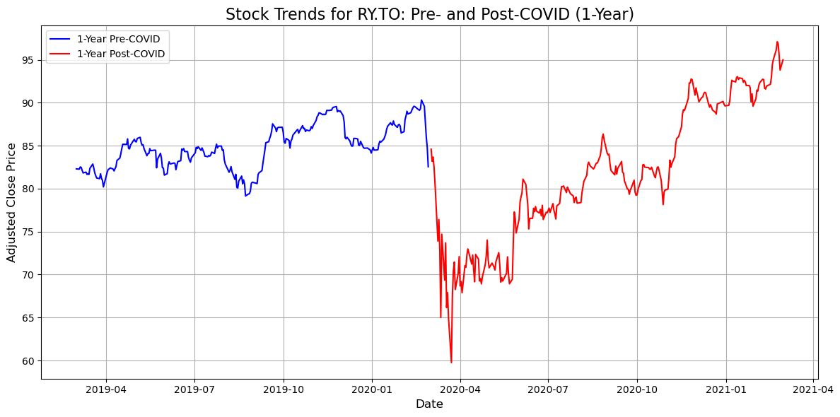
RY - Royal Bank of Canada
Sector: Financial Services
Industry: Banks - Diversified
Full Time Employees: 96,165

Slide 15
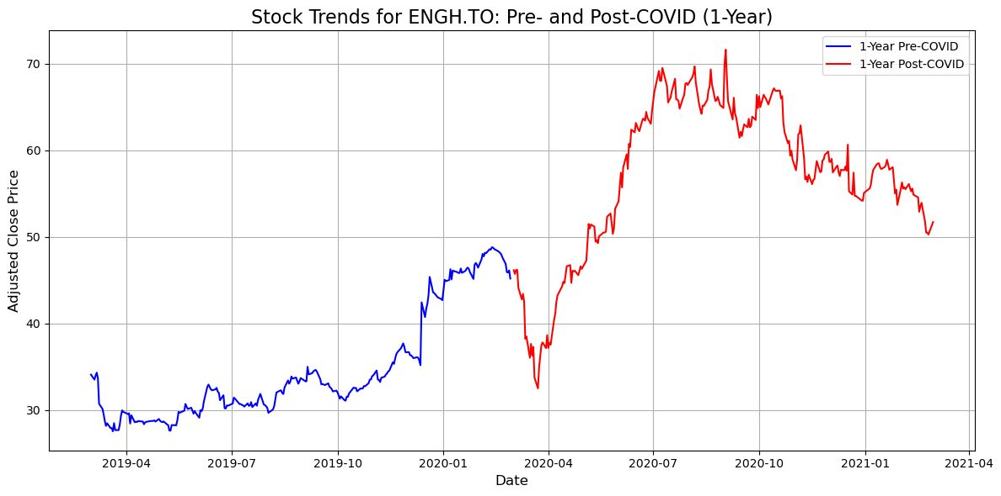
ENGH - Enghouse Systems Limited
Sector: Technology
Industry: Software - Application
Full Time Employees: 1,882

Slide 16
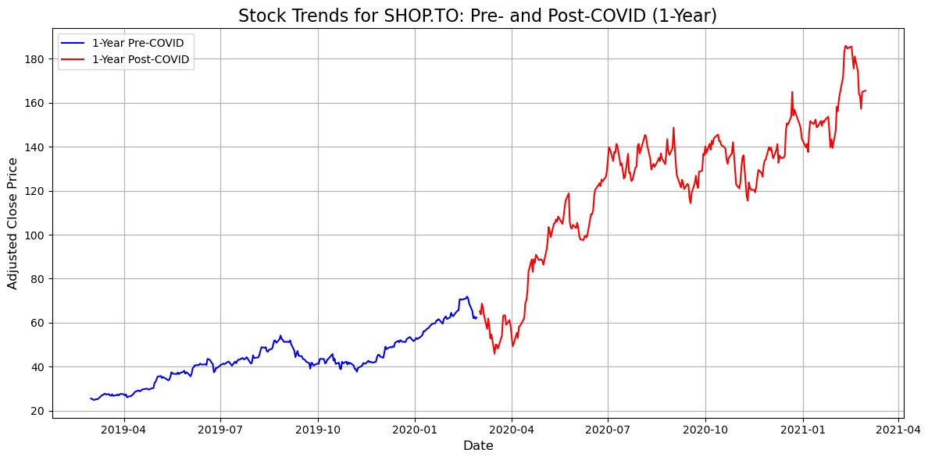
SHOP - Shopify Inc.
Sector: Technology
Industry: Software - Application
Full Time Employees: 8,300

Slide 17
Conclusion
Covid has affected our lives in many different ways. All provinces in Canada have been affected.
The stock market is more affected by fear itself than by the actual consequences of the cause of that fear.
Due to COVID, some sectors, such as technology companies, rocketed despite the overall market decline. With everybody at home, this sector received investments to help the world keep functioning.
After the initial impact, the stock market experienced an increase in transaction volume as people began to see opportunities to increase their profits or recover their losses.

Slide 18

Q & A

Slide 19
Thank you!

